Slide 1
Age of Absolutism
By Cranky Mr. Bredberg

Slide 2
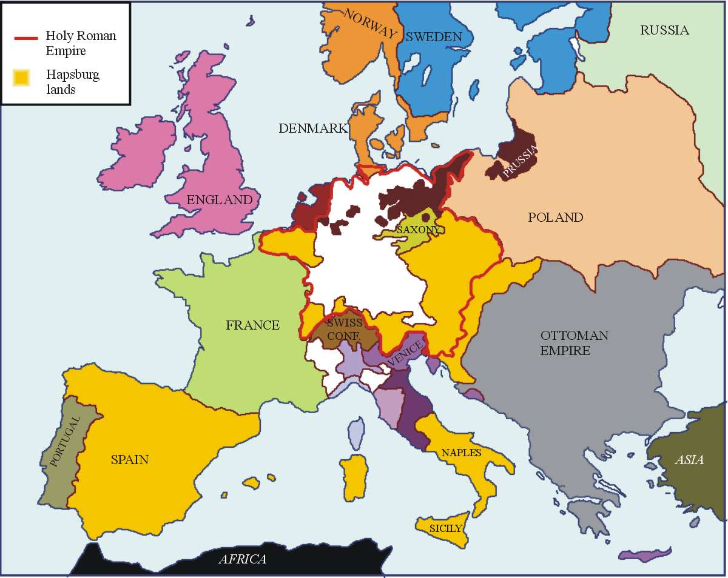
Europe 1520

Slide 3
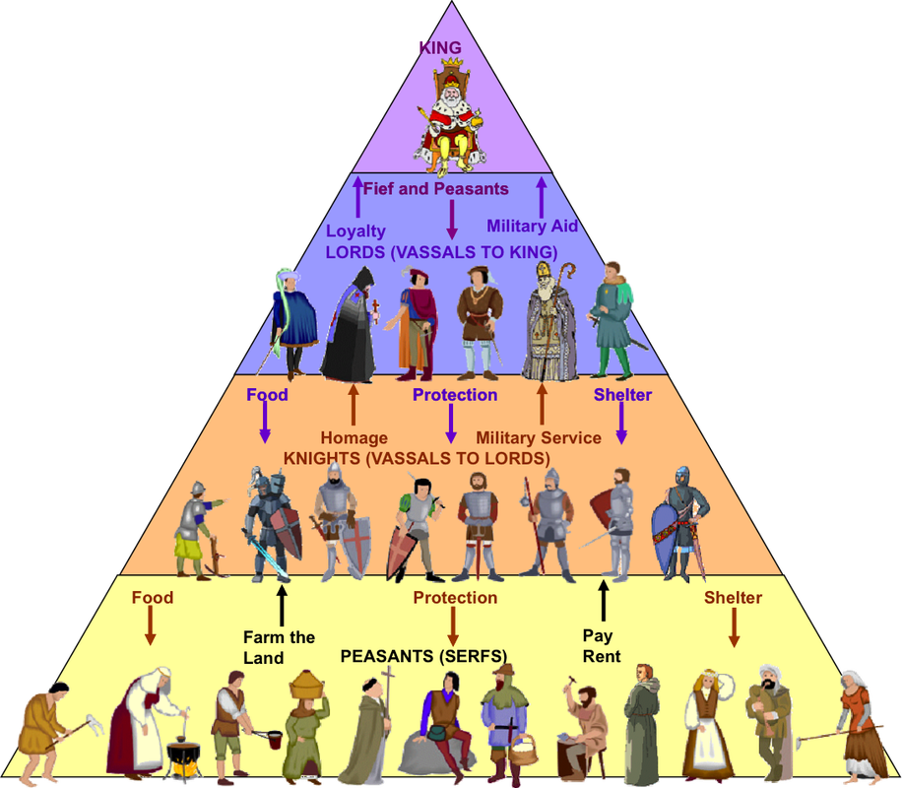
Feudalism
Feudalism was a social system in which nobles pledged their loyalty to a monarch in exchange for land and safety.
Feudalism developed in the Middle Ages as a reaction to the collapse of the Roman Empire.
Not a formal system, but a series of relationships between local nobilities based:
Family connections.
Constantly shifting loyalties.

Slide 4
Age of Absolutism
In Europe, the Age of Absolutism runs from 1550-1800.
The power of monarchs across Europe rises because:
Reconquista- Required serious military centralization and the creation of a strong monarchy in Spain.
American Wealth-Economic wealth from the Americas develops national economies.
Atlantic Trade- Only centralized power could control trade.
Church in Decline- Reformation undermined the Church.

Slide 5
Absolutism
Monarchs claim their right to rule is based on Divine Right.
Divine Right- Authority comes from God directly.
Features of Absolute Monarchy
Strong Armies and Constant Warfare
Limited Representative Bodies
Weakened Nobility
High Taxes
Monarch is “Above the Law”

Slide 6
Effects of Absolutism
Regulation of Religion and Society
Loss power by nobility and legislatures
Bureaucracies
Huge building projects

Slide 7
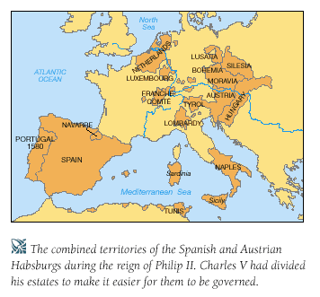
Absolutism in Spain
The Hapsburg Royal Family controls much of the Catholic territory of Europe.
Family becomes the chief defender of Catholicism.
The Spanish Golden Age comes under the reign of Philip II.
Wealth from American colonies makes Spain wealthy.
Invests in art and literature.
Expands the Spanish military, especially its navy.

Slide 8
Spanish Armada
Provocation- The English had long been preying on Spanish shipping in the Atlantic.
English monarchs had been paying privateers to capture Spanish treasure.
1588, Philip II orders an attack on England.
Launches an invasion of England.
The Armada, incredibly, is defeated by the English defenders and cripples Spanish power.
Spain enters a long, slow period of decline.

Slide 9
Absolutism in France
The Bourbon Family
Henry IV begins the process of slowly accruing power to himself.
Louis XIII strengthens the French national military- makes himself less dependent on his nobility.

Slide 10
Louis XIV – The Sun King
Ruled France for 72 years.
Develops the colonies in the Caribbean and Canada.
Persecuted the French Protestants
Never called the Estates General (the legislative body of the French Kingdom)
Turns France into one of the most powerful nations in Europe.

Slide 11
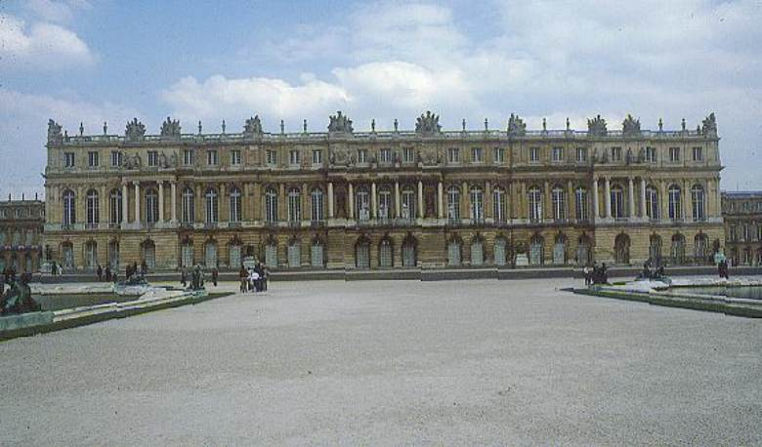
Palace of Versailles
Builds an enormous palace to entertain his nobility.
“Gilded Cage”
Keeps his nobles drunk and gambling while he takes more and more of their power!

Slide 12
Russia under Absolutism
Ivan the Terrible was born the Prince of the City of Moscow
Spent much of his childhood in fear as his family members were constantly trying to kill him.
Ivan the Terrible unifies all of Russia for the first time since the Mongolians were driven out.
Proclaims himself to be “The Czar of All Russians.”

Slide 13
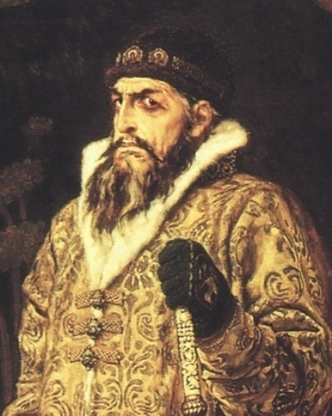
Ivan the Terrible: Domestic Policy
Begins modernizing Russia
Establishes a national, standing army.
Revises the law code.
Creates a Russian Parliament.

Slide 14
Ivan the Terrible: Paranoia
In the 1560s, Russia becomes involved in a series of wars against the Lithuanian Commonwealth and is blockaded by Sweden and some German states.
One of his nobles poisons his wife, killing his unborn child in the process.
Another, Prince Kurbsky, defected to the Lithuanian invaders and helps to devastate a large part of Russia.
After these betrayals, Ivan launches internal purges, killing suspected traitors in large numbers.
Pushes his forces outwards, conquering several of Russia’s smaller neighbors and gaining a port on the Baltic Sea.

Slide 15
Peter the Great
Reigns from 1682-1696.
Peter focuses on modernizing Russia and transforming it into a world power.
Builds the city of St. Petersburg: “The Window to the West.”
St. Petersburg was useful because it was a warm water port.
Travels to Western Europe to learn how to develop a modern state and introduce new technologies.

Slide 16
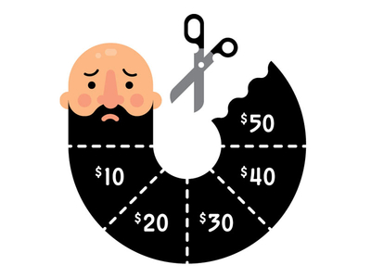
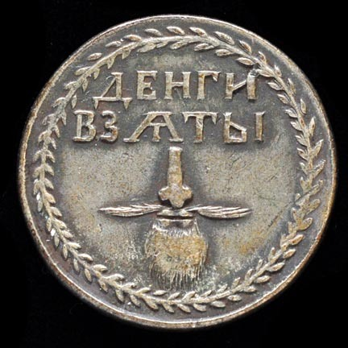
That villain Peter also introduced a “beard tax.”

Slide 17
England Under Absolutism?
England long had a Parliament (legislative body) which checked the power of England’s monarchs.
The Tudor Monarchs (1485-1603) generally worked with Parliament.
After Elizabeth I’s death, the House of Stuart comes to power.

Slide 18
England and the Stuarts
Stuarts had absolutist tendencies, particularly with regard to Divine Right.
James I constantly clashed with Parliament over finance and foreign policy.
Puritans, a sect with the Anglican Church, was very hardline and angered by James I.
After James I dies, Charles I comes to power and begins implementing horrible punishments to those who oppose him, including torture, disfigurement, and death.

Slide 19
English Civil War
Eventually, Charles I’s absolutist tendencies trigger the English Civil War.
Fought between two factions: Royalists and Parliamentarians. (King vs Parliament.)
Parliament’s forces, led by Oliver Cromwell, are victorious and execute Charles I.
The monarchy is abolished.
Cromwell declares the Commonwealth of England, Scotland, and Ireland.
Declares himself “Lord Protector” of the Commonwealth, effectively becoming a military dictator.

Slide 20
Restoration
Cromwell reigns for 20 years, until his death.
Parliament restores Charles II to the throne, out of concern for another military dictator.
Charles dies and his son James II becomes king.
James II begins pushing for absolutist control, so Parliament overthrows James II.

Slide 21
Glorious Revolution
Parliament asks William and Mary (two Dutch nobles) to become the King and Queen of England.
Forced to sign the English Bill of Rights, which guarantees Parliament’s superiority over the Monarchy.
England becomes a Limited Monarchy.

