Slide 1
Causes of the American Revolution

Slide 2
Attitudes Amongst the Colonists
Most colonists believed in “English Liberty” and identified as British.
Feared France and the Catholic Church.
Were mostly Whigs:
Whigs
Parliament over King
Expand voting rights

Slide 3
French Canada
French Canada was much more sparsely populated than English America.
French were generally more friendly with local Indians, with whom they traded.
The French were nervous at the speed with which the British colonies were growing.
Begin building forts in case the British decide to invade.

Slide 4
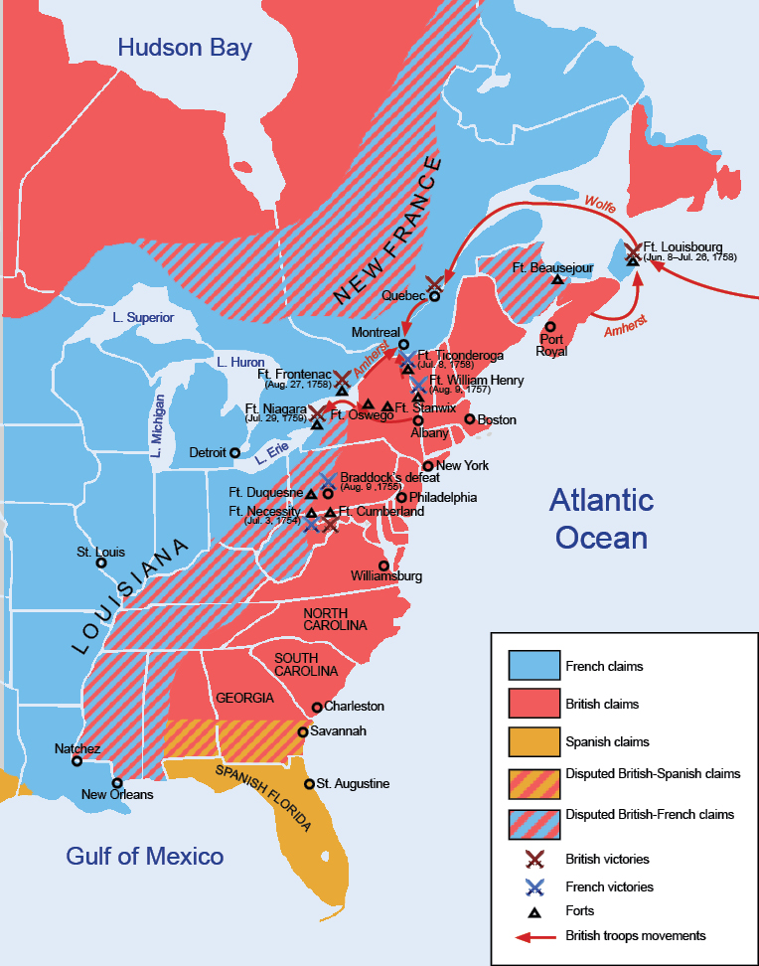
French and Indian War
France and Britain had long had an intense rivalry for power in Europe.
Border dispute in Western Pennsylvania will trigger a global war: George Washington accidentally starts it.
First world war. Fighting takes place in:
North America
Caribbean
Europe
Africa
Asia

Slide 5
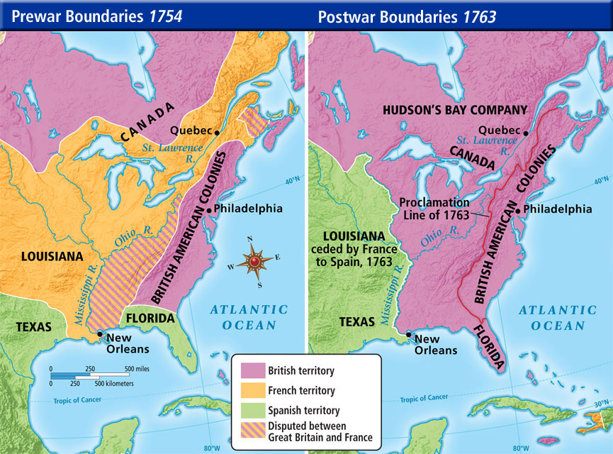
Britain Wins the War
Britain wins the war.
France lost Canada to the British.
The future seems bright for the British Empire.
However, the British ran up huge debts to win.

Slide 6
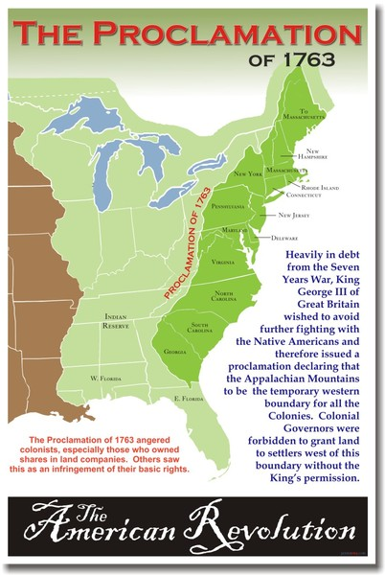
Problems: The Proclamation of 1763
With France gone, many colonists were excited about being able to settle west of the Appalachian Mountains (particularly the Ohio Valley.)
Many Indian tribes lived in the area, however.
The British government, broke and weary of fighting, did not want to wage another campaign against the Indians.
The British issue the Proclamation of 1763, which forbid colonists from crossing the Appalachian Mountains.
Angers many colonists.

Slide 7
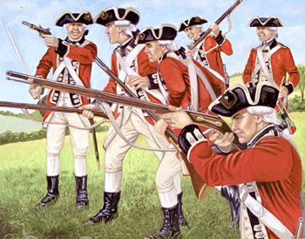
Problem: British Occupation
After the French and Indian War, the British Army kept soldiers in American east coast cities.
Nominally they were there two reasons:
Enforce the Proclamation of 1763.
If that is true, why are most of these soldiers in east coast cities?
Protect the colonies from foreign powers.
Which powers? France is gone, Spain is weak, and the Indians no match for colonial militia.

Slide 8
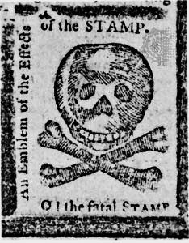
Problem: Taxes
The British government wanted to pay off the war debt.
The colonists were paying the lowest tax rate in the world.
British decide to levy a small tax against the colonists to pay down the debt.
Sugar Act- Placed a tax on sugar.
Stamp Act- Place a tax on all printed goods.
Tea Tax- Tax on all imported tea.

Slide 9
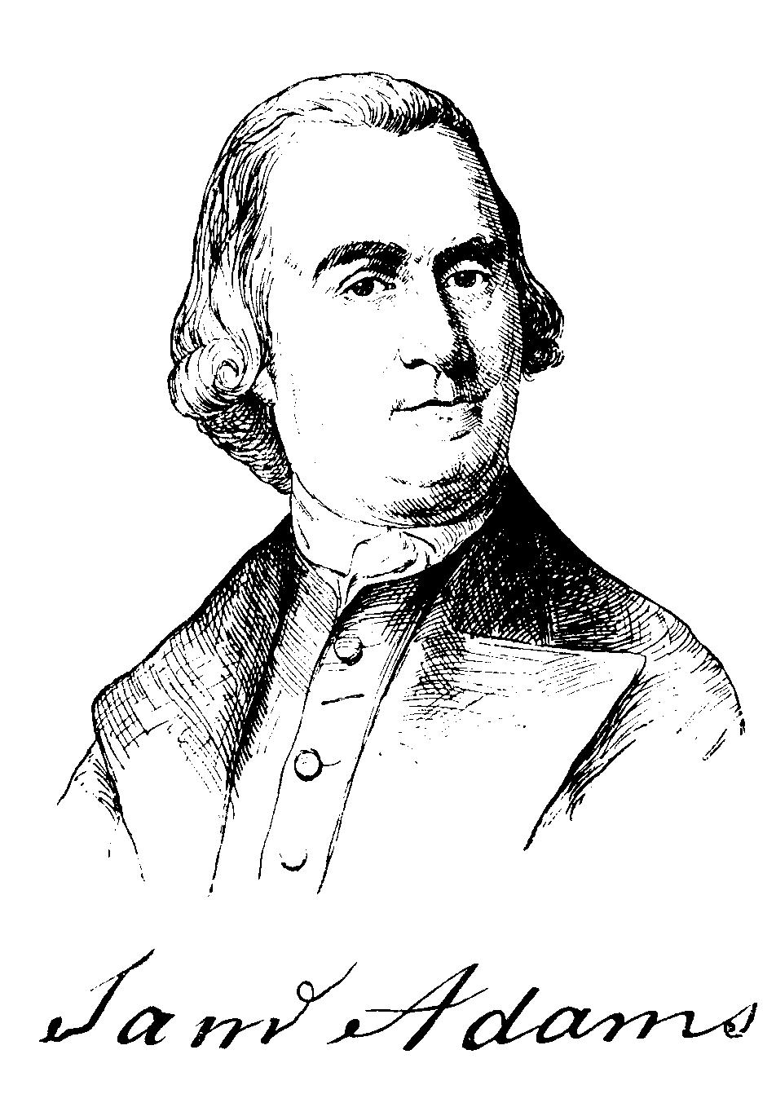
Response: Sons of Liberty
Disaffected colonists begin to establish local Sons of Liberty groups.
Sons of Liberty:
Attack tax collectors.
Burn the Gaspee.
Tar and Feather government agents.

Slide 10
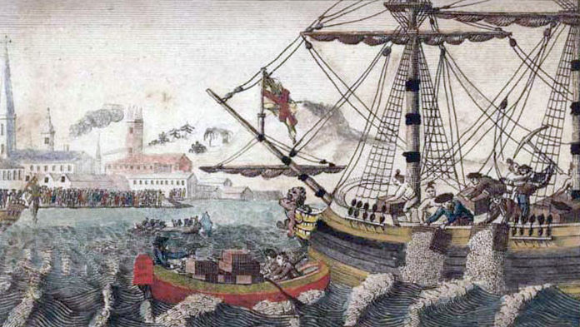
Response: Boston Tea Party
Boston Tea Party- Local Sons of Liberty destroy a cargo of tea in Boston harbor to protest tea taxes.
Dress as Mohawk Indians for plausible deniability.
British are furious and decide that they have to respond to the provocations.

Slide 12
The Intolerable Acts
The Massachusetts colonial government is deposed and a military government is installed.
The port of Boston is closed until the tea is paid for.
Quartering Act was passed, which required colonists to put soldiers up in their home, if needed.
Unrelated, but poorly timed: Quebec Act
Guaranteed French Canadians religious freedom.
Created the administrative district of Quebec, which included Canada and the Ohio Valley.

Slide 13
Colonial Response to the Quebec Act

