Slide 1
Haitian Revolution

Slide 2
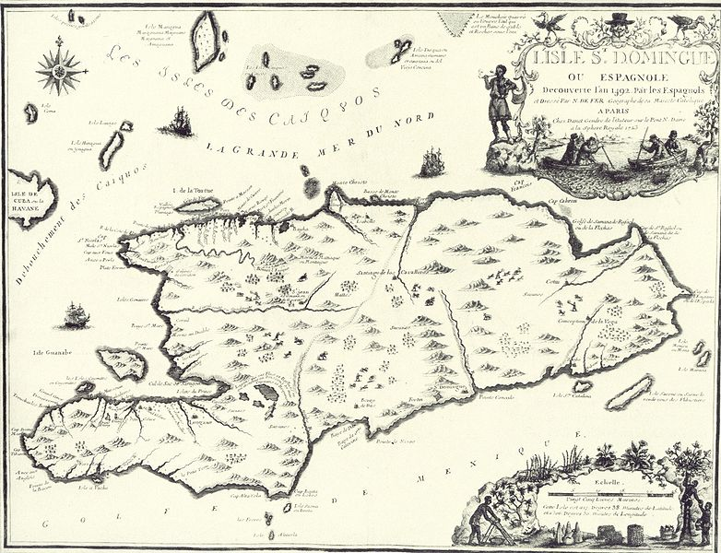
History of Colonization
Haiti had been colonized by the Spanish in the 1490s.
The indigenous population was killed off either by smallpox or violence.
Haiti was taken from Spain by France in 1697.
The French renamed the island Saint-Domingue

Slide 3
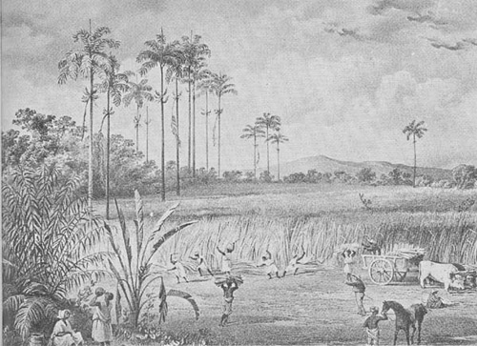
Value
Haiti was a prime exporter of sugar.
Europeans had become addicted to sugar and Haiti was perfect for its cultivation.
Very harsh conditions

Slide 4
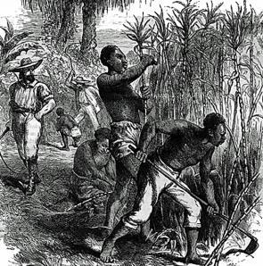
Conditions
1681 there were 2,000 African slaves in Saint Domingue; by 1789 there were almost half a million.
Sugar Plantations averaged a 300% turnover rate per year.
Cheaper to import new slaves than to improve working conditions.
Many thousands, especially pregnant slaves, committed suicide.
Legal to kill slaves with no retribution.

Slide 5
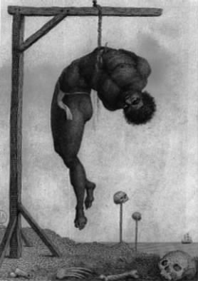
Torture
Torture of slaves was routine:
they were whipped
burned
buried alive,
restrained and allowed to be bitten by swarms of insects,
mutilated
raped,
and had limbs amputated.
Slaves caught eating the sugar cane would be forced to wear tin muzzles in the fields.

Slide 6
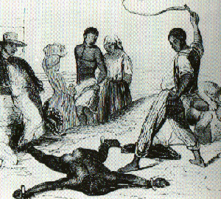
Roots of Resistance
Period slave revolts, always put down.
Maroon communities of escaped slaves popped up on the margins
Often raided French plantations
Bandit-heroes
Francois Mackandal was the most famous of these raiders.
Eventually caught and burned alive.

Slide 7
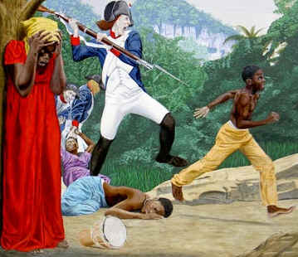
Roots of Resistance
Importing captured Africans-
Knew what it was to be free
Often had some military training
8x as many slaves as white French/mixed race collaborators.

Slide 8
French Revolution
In 1791 the National Assembly comes to power.
Declaration of the Rights of Man- abolishes slavery and states that all men are born free and equal.
French plantation plan to stage a revolt against France and strengthen their own control over their slaves
France, invaded by many neighbors, cannot do anything.

Slide 9
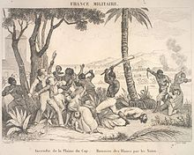
Outbreak of the Revolution!
Despite the uncertainty of what is coming, the National Assembly holds onto power in Haiti.
Spain, however, is threatening the island.
National Assembly sends General Sonthonax to the island to protect it from the Spanish and slave uprisings.
Slave uprising occurs anyway.

Slide 10
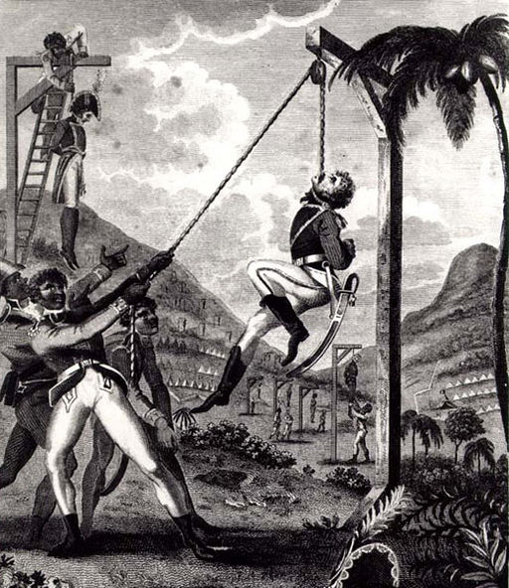

Slide 11
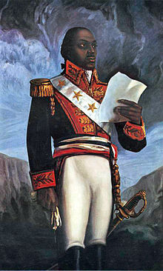
Toussaint L'Ouverture
A free black man who comes to lead the slave rebellion.
Accepts some assistance from the Spanish to fight the French.

Slide 12
Outbreak of the Revolution!
General Sonthonax, in an attempt to undermine the slave uprisings and prevent independent action, abolished slavery.
L'Ouverture brokers a tentative agreement with the French to establish a power-sharing agreement with Sonthonax.
L'Ouverture was willing to allow Haiti to remain a French colony if slavery was not reintroduced.

Slide 13
The Directory and the Revolution
The Directory was much less excited about the semi-autonomous nature of Haiti and tried to undermine some of its accomplishments.
L'Ouverture was able to stymie them, however.
Rumors began to swirl that the Directory would re-introduce slavery.
Caused tension on the island.

Slide 14
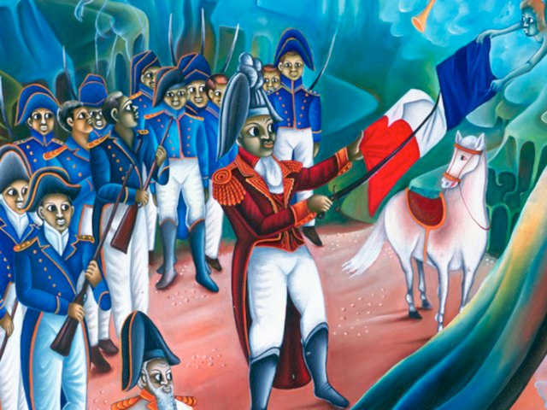
Napoleon and the Revolution
Napoleon determined that, while he was fine with the end of slavery, he would be reasserting more control over the island.
Begins to write a new constitution for the island.
L'Ouverture pre-empts him and prepares his own Constitution and submits it for a vote in 1801.
Napoleon is furious.

Slide 15
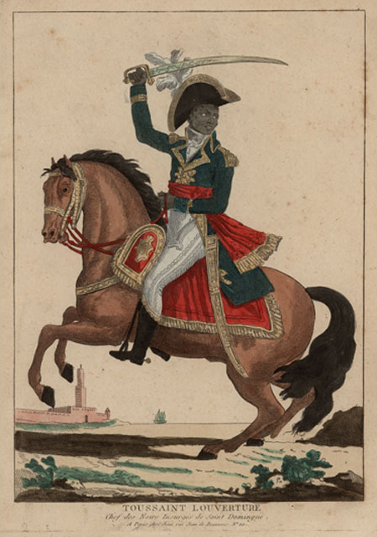
Invasion
Napoleon dispatched 20,000 men under the command of his brother-in-law, Leclerc.
Was instructed to take the island peacefully and then betray and capture L'Ouverture and other black leaders.
L'Ouverture, worried, prepared the defenses of the island.

Slide 16
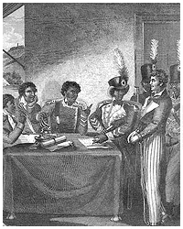
Violence and Betrayal
Months of inconclusive fighting followed.
L'Ouverture’s troops faced off with the French in the mountainous interior, holding them at bay.
Leclerc asked to negotiate: Eventually, L'Ouverture agreed.
Had L'Ouverture arrested and deported to France.

Slide 17
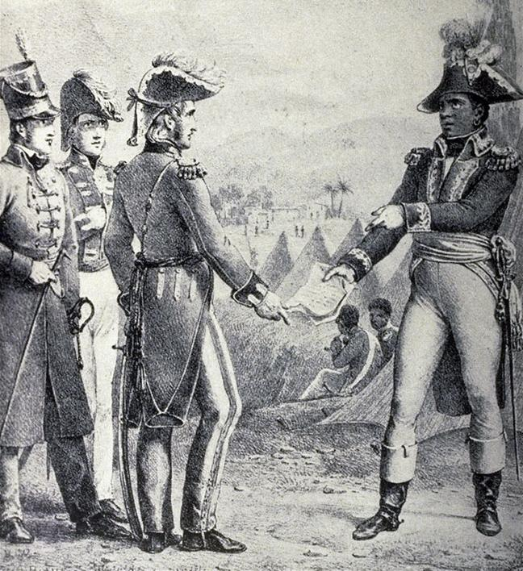
L'Ouverture and Defeat
“In overthrowing me you have cut down in Saint Domingue only the trunk of the tree of liberty; it will spring up again from the roots, for they are many and they are deep.” - L'Ouverture on his capture.
L'Ouverture dies in prison six months later.

Slide 18
Continuation of the Fighting
War between France and England resumed in 1803; Britain blockades France. Napoleon cannot send reinforcements to the French garrison.
After selling Louisiana to the US, Napoleon began to lose interest in the Western Hemisphere.
Napoleon grew more concerned about the fighting in Europe and withdrew much of the troops he had dispatched to Haiti.

Slide 19
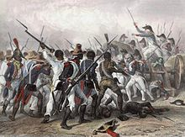
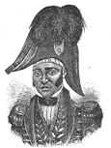
Continued Fighting
Many of the French begin to die from Yellow Fever.
Increased rebel attacks, under the command of Jean Jacques Dessalines.

Slide 20
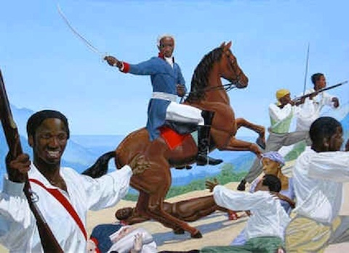
Free Haiti
Finally the French garrison is defeated and Dessalines declares a Free Haitian Republic.

Slide 21
US and Haitian Relations
While President, George Washington provides assistance to the French in crushing the rebellion.
While President, John Adams provides assistance to the rebels.
While President, Thomas Jefferson provides assistance to the French in crushing the rebellion.

Slide 22
US and Haitian Relations
Division in the United States
Some, mostly in the North, want to help the rebels. → Consistent with the American Rev.
Some, mostly in the South, want to help the French. Terrified of the possibility of Haiti creating slave rebellions at home.
Southern Senator: "the antislavery movement had provoked the revolt in the first place."
Does, in fact, cause slave revolts in the United States, particularly in Louisiana.
Congress outlaws the immigration/importation of any Haitians to America.
Reactionary slave-owners prevent the government from allowing recognition of Haiti, fearing that a black ambassador would undermine slavery in America.

