Slide 1
Industrialization II

Slide 2
Wealth Inequality
Robber Barons had captured most of the world’s wealth.
Standard of living, despite many inventions and new production levels, actually declines for many (most?) workers in the Industrial World.

Slide 3
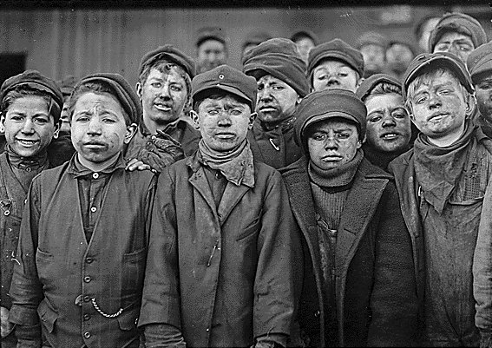
Industrial Age Life
Work Life
10-14 hours/day.
6 days/week.
Laid-off 5-7 times/year.
No vacation.
No workplace safety.
No retirement.
VERY low standard of living.
Child labor extensive.

Slide 4
Gap Between Rich and Poor
Robber Barons, wealthy industrialists, build vast fortunes.
10% of population owns 90% of wealth
2/3 of the population were working class, employed by someone else.
Carnegie’s retirement- $44,000/day, which is 88X the average yearly salary of his employees.
J. P. Morgan once wrote a check to prevent the Federal Government from declaring bankruptcy.

Slide 5
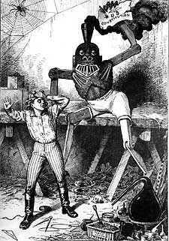
Worker Reactions to Industrial Life
Very, very unhappy.
Periodically break out into strikes,
often violent.
The most impressive of these is
the Great Strike of 1877 in the
United States.

Slide 6
Famous Strikes and Riots: The Great Railroad Strike
After cutting wages, workers went on strike across East Coast → led to Riots
President Hayes called in state militias which caused problems → led to over 100 dead before strike ended
Result:
Workers are compelled to go back to work.
Government creates the National Guard to replace the state militias.

Slide 7
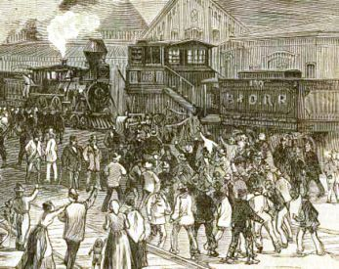

Slide 8
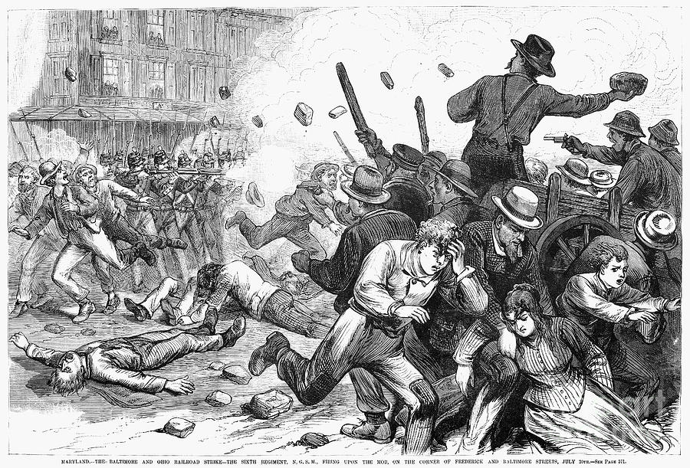
Soldiers firing on workers in Baltimore

Slide 9
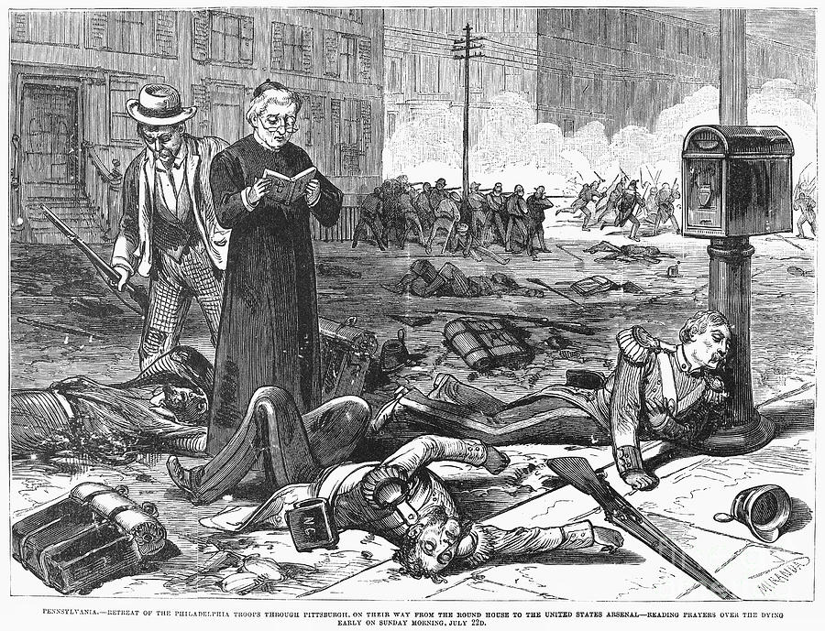
Retreating soldiers injured in the Great Strike of 1877

Slide 10
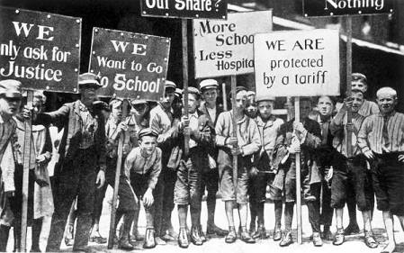
The Children’s Strike

Slide 11
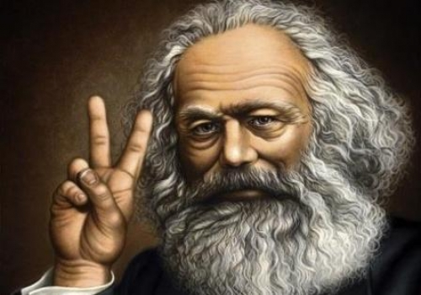
Is there any alternative?

Slide 12
Theoretical Responses to Industrialization

Slide 13
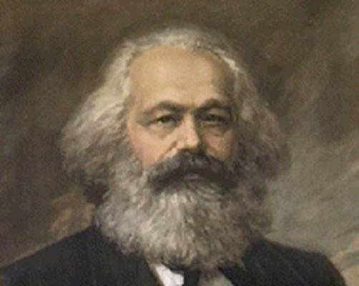
Karl Marx
Karl Marx (1818 – 1883) was a German economist who was exiled to England.
He wrote Das Kapital, which explained how he thought capitalism would fall, and also the Communist Manifesto, which told the workers of the world to unite and fight the factory owners.

Slide 14
Marxist Vocabulary
Proletariat are the working class, or people who must exchange their labor for cash.
Bourgeoisie are the wealthy class, which own the means of production.

Slide 15
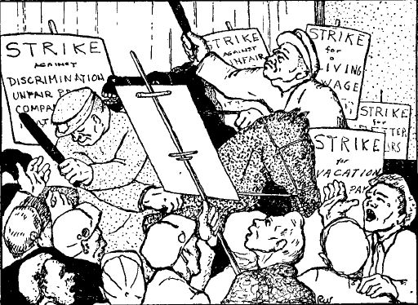
What is Marxism?
Marx argues that the history of the world is a history of class struggle: The common people versus their masters.
“Hitherto, every form of society has been based ... on the antagonism of oppressing and oppressed classes.” –Karl Marx

Slide 16
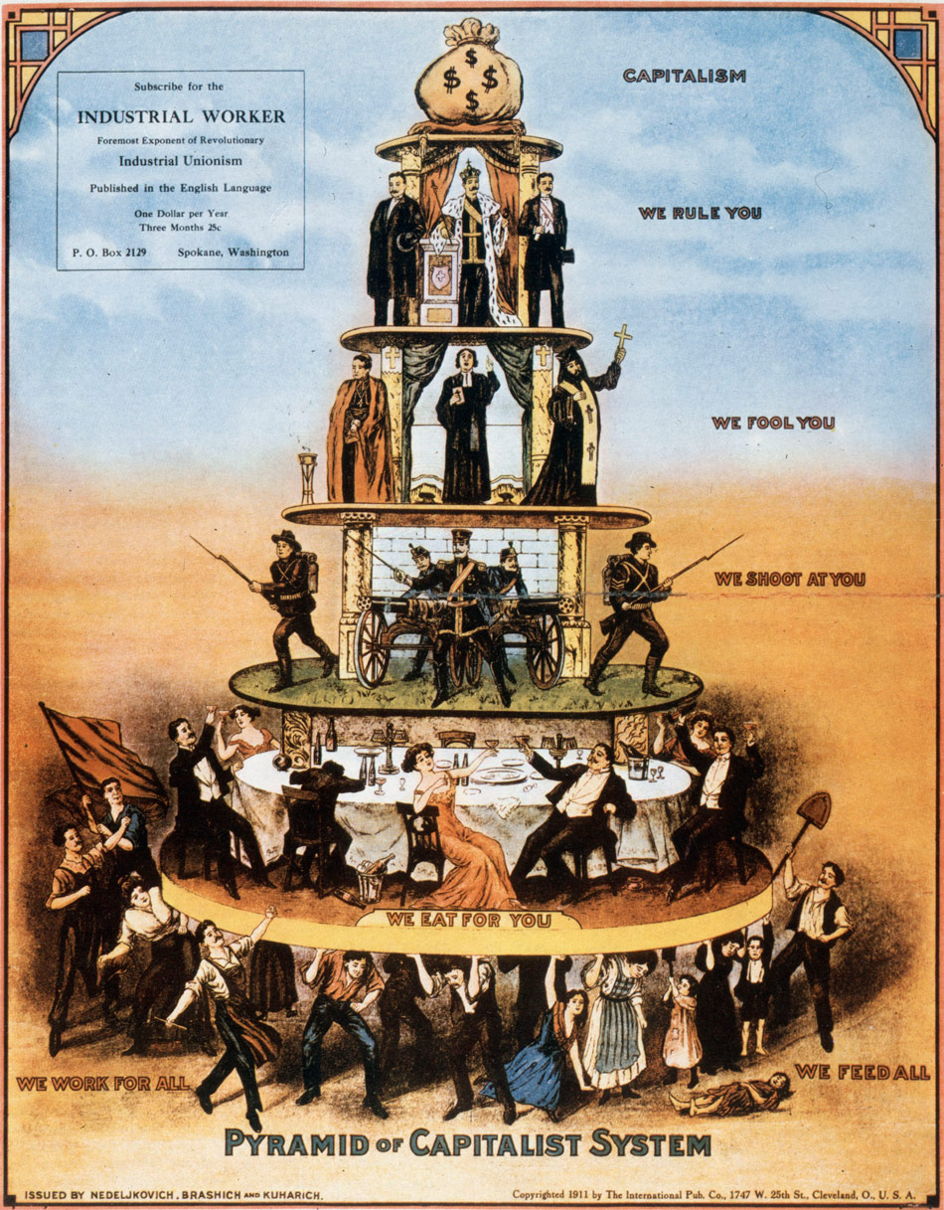

Slide 18
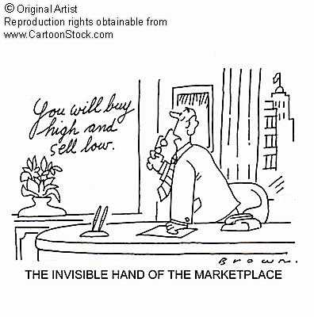
Surplus Value
Marx believed that the bourgeoisie basically bought the products of the laborers at a cheap price, and then sold those same products back to them at a high price, in effect stealing the surplus value as their profit.

Slide 19
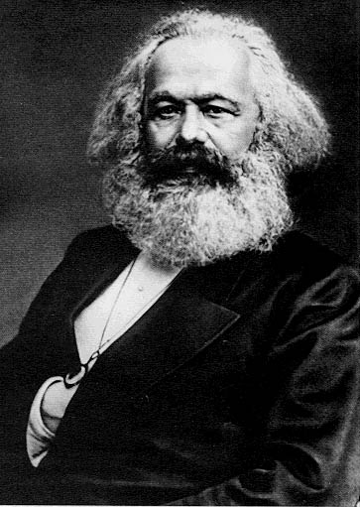
Karl Marx says…
“The ideas of the ruling class are in every epoch the ruling ideas…”
“The ruling material force of society, is at the same time its ruling intellectual force.”

Slide 20
Inevitability of Socialism
Marx argued that over time, capital (money) would concentrate in the hands of a small number of capitalists.
Finally, the lower class would rise up, overthrow the capitalists, and establish a Dictatorship of the Proletariat.

Slide 21
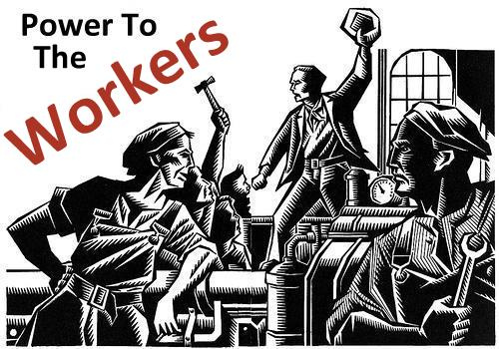
Dictatorship of the Proletariat
At first, the Dictatorship of the Proletariat would need absolute powers to make sure the bourgeoisie don’t bring back capitalism.

Slide 22
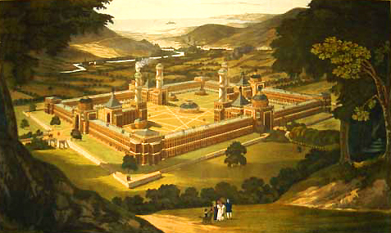
But before long, the workers would learn to share everything equally – “from each according to his abilities, to each according to his needs.” Karl Marx called this Communism, or the Ultimate Classless Society.

Slide 23
Marx Appeals to Workers Because…
Workers want a more equitable society and to restore their dignity in the workplace.
Workers want security for themselves and their families.

Slide 24
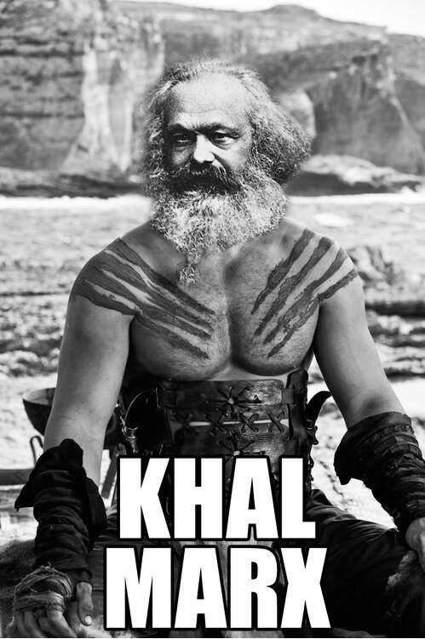

Slide 25
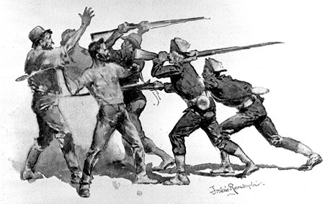
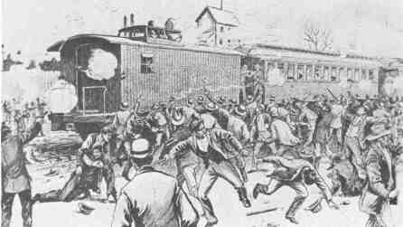
Pullman Strike
Pullman Strike was a rail worker strike, demanding an end to the idea of the company town.
The rail companies sent in strike breakers and goons to break the strike, but the strikers beat them back.
Finally, President Cleveland sent in the army, broke the strike, and arrested its leader, Eugene Debs.

Slide 26
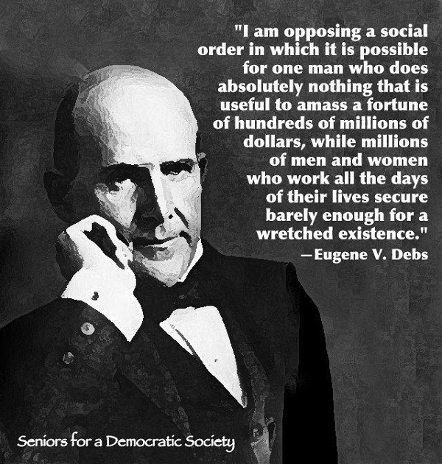
Radicalism: Debs
Eugene V. Debs from Indiana.
Helps found and leads the American Railway Union in the 1880s.
Participates in the Pullman Strike and is arrested.
While in prison, he becomes radicalized and joins the Socialist Party.

Slide 27
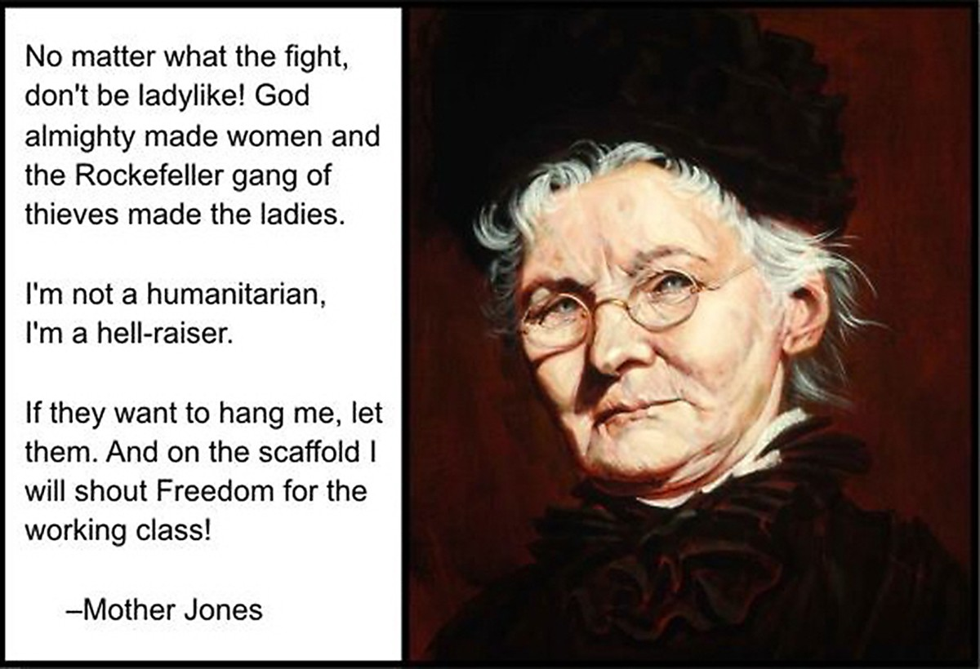
Radicalism: Mother Jones

Slide 28
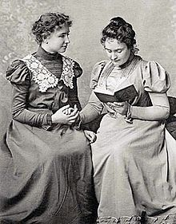
Radicalism: Helen Keller
“What are we organized for? What is our chief bond of unity? What is our avowed object? The welfare of the working class and the abolition of capitalism.”
–Helen Keller

Slide 29
“I am said to be a revolutionist in my sympathies, by birth, by breeding and by principle. I am always on the side of the revolutionists, because there never was a revolution unless there were some oppressive and intolerable conditions against which to revolute.” –Mark Twain
Radicalism:
Mark Twain

