Slide 1
Industrialization
World History

Slide 2
Understanding the Industrial Revolution
Industrialization simply means Machine Production, or using machines to produce goods.
Industrialization changes:
Emigration from country to city.
Factories dominate worker’s lives.

Slide 3
Positive Effects of Industrialization
New technologies are developed
New Jobs are created
Vast fortunes are created
Immigration
Cities Grow

Slide 4
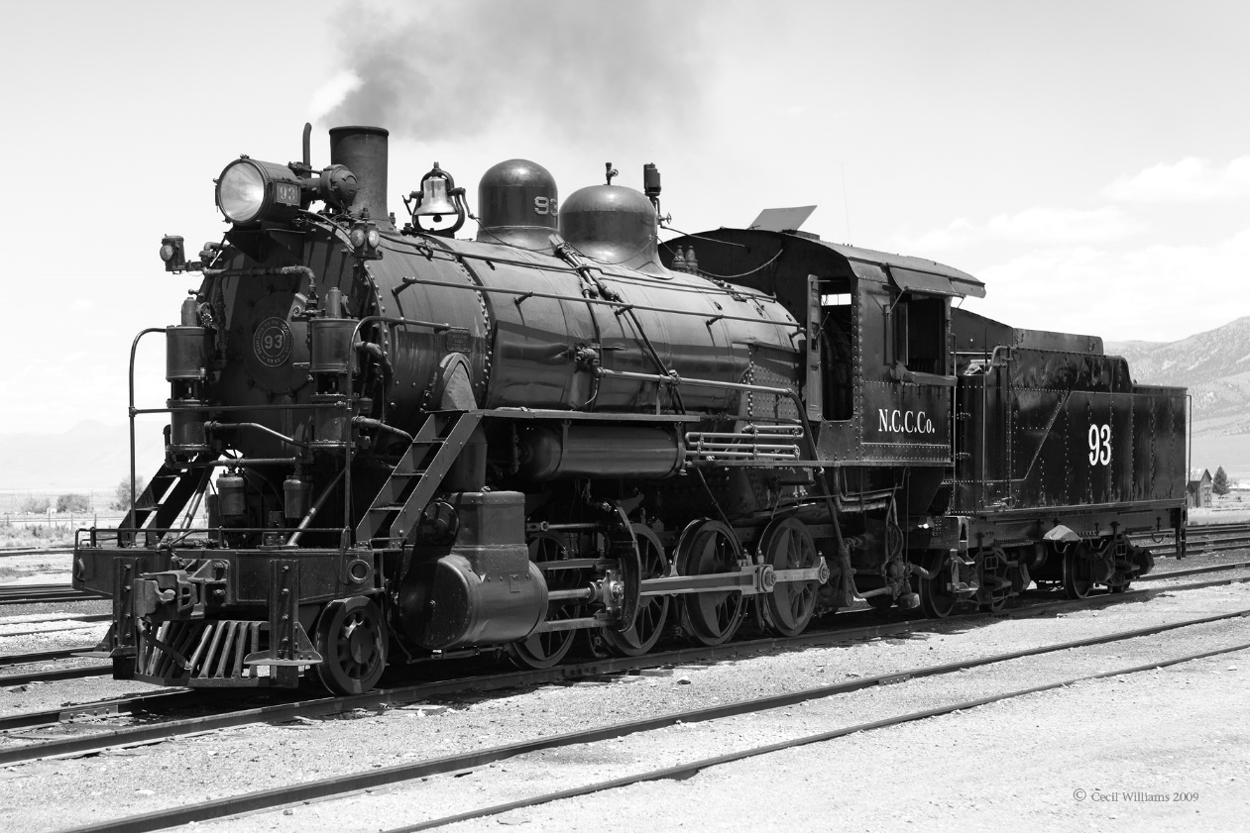
New Technologies
Railroad
Electric Lightings
Steamship
Telegraph

Slide 5
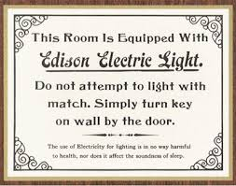

Slide 6
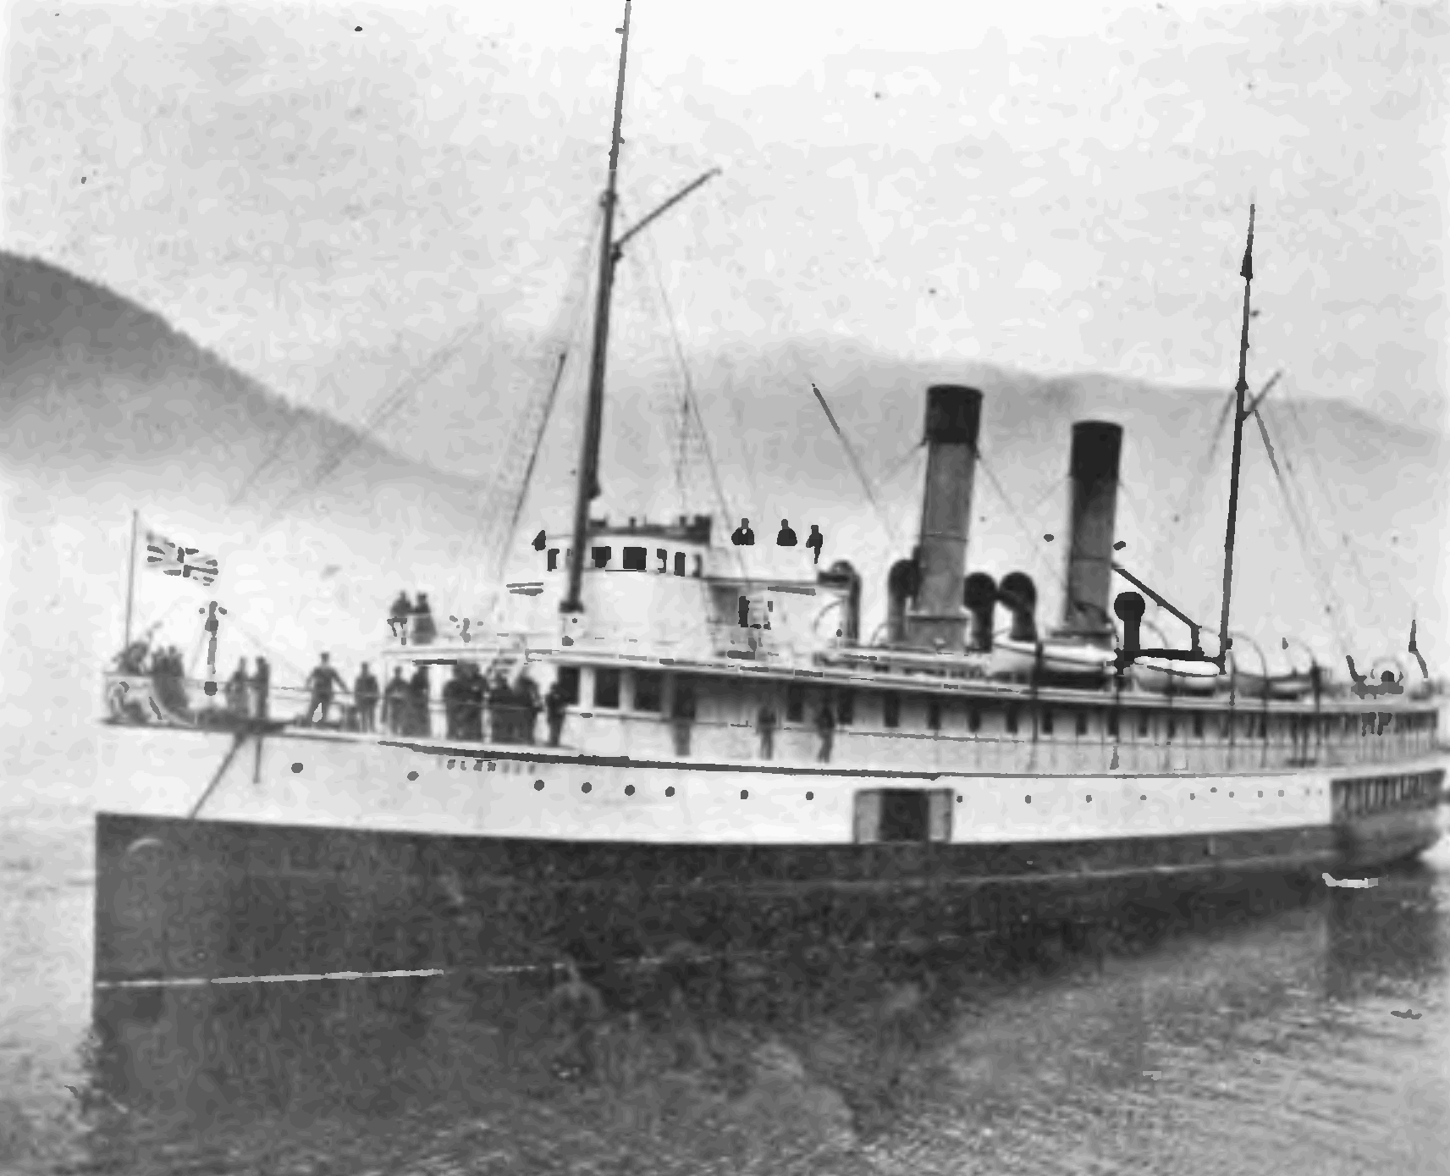

Slide 7
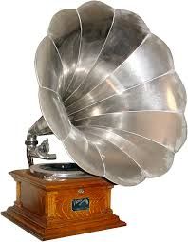

Slide 8
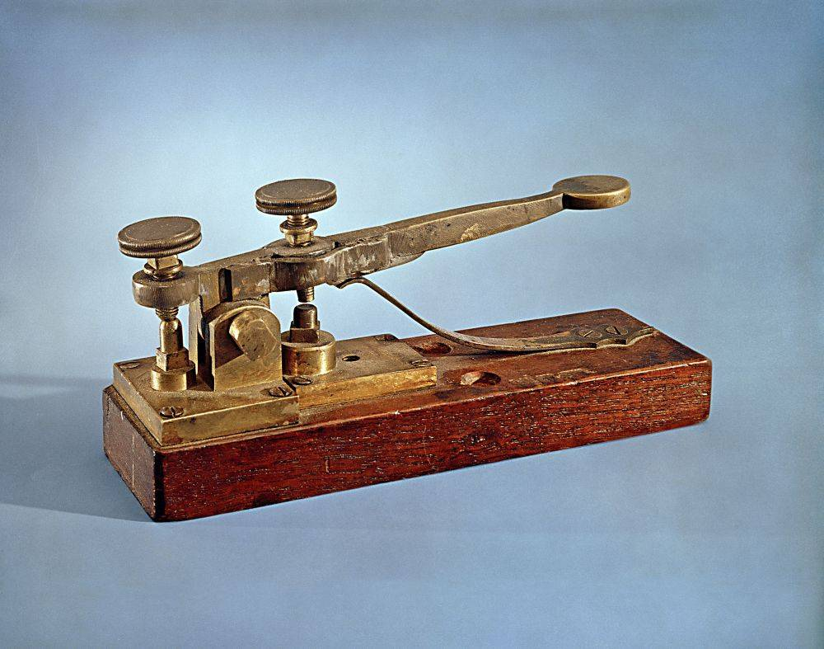

Slide 9
Negative Effects of Industrialization
Pollution
Inequality and Poverty
Child Labor
Political Corruption

Slide 10
Taylorism= Scientific Management
Production process should be divided into specialized tasks.
Each task speeds up production
Train all workers to do unskilled jobs
Goal: “Makes workers interchangeable”

Slide 11
Industry and the Workers
Working Conditions:
Dangerous: People lose fingers, limbs, become physically handicapped, stooped over, and other health problems.
Long Hours- 12 -14 hour workdays, 6 days a week.
Women and children paid less
Physical Abuse- Beatings and sexual harrassment
Fast work pace- Machines forced workers to work faster
Monotonous work, or doing the same job all the time.

Slide 12
Life at Home
Employment
Average family makes ~$500/year.
Laid off 5-7 times/year.
Tenements
Tenements often lack windows/proper ventilation.
Often crowded and contained multi-generational families.

Slide 13
Safety and Unemployment
No employment insurance
No medical help if hurt on the job
No retirement
No minimum wage
No safety requirements

Slide 14
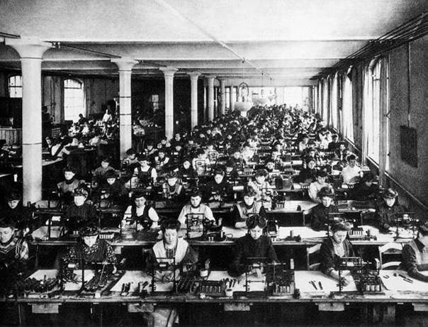

Slide 15
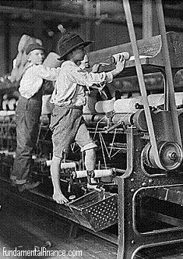

Slide 16
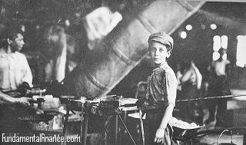

Slide 17
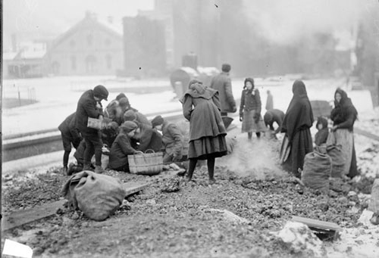
Chicago coal gleaners

Slide 18
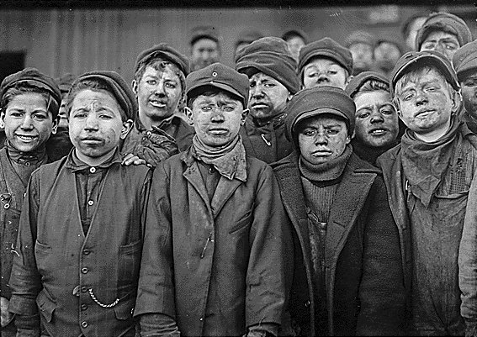

Slide 19
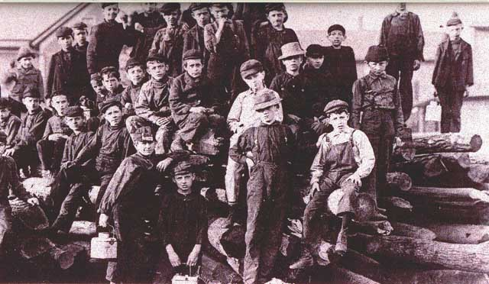

Slide 20
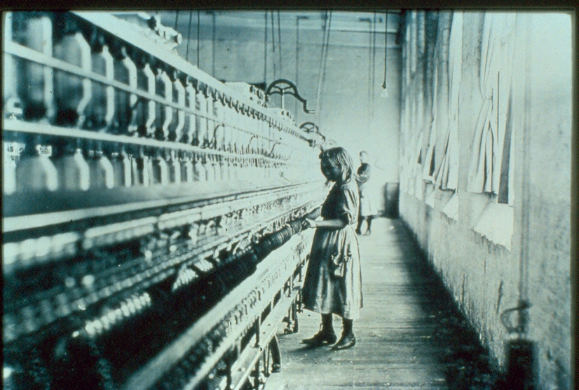

Slide 21
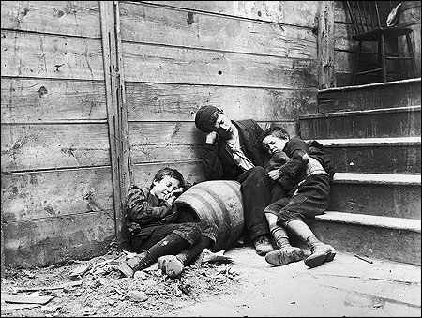

Slide 22
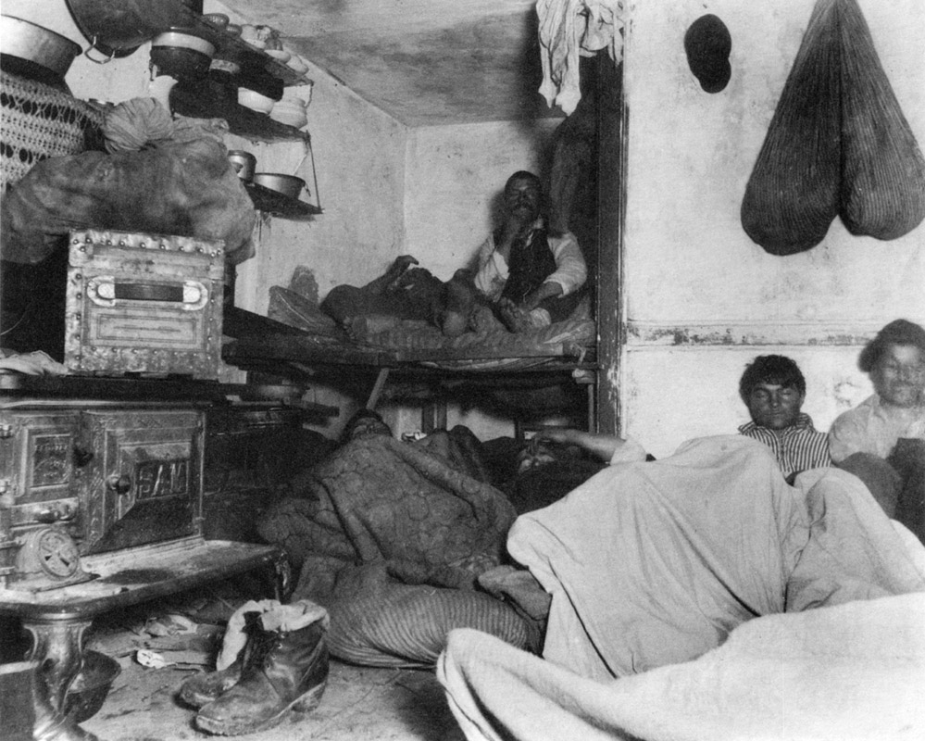

Slide 23
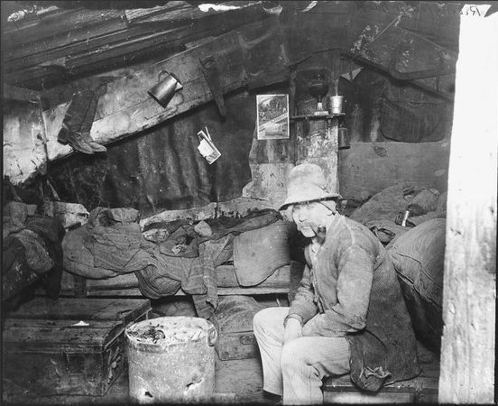

Slide 24
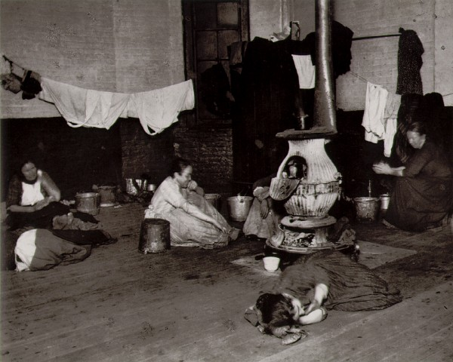

Slide 25
Free Enterprise: Capitalism
Adam Smith: The Wealth of Nations (1776)
Laissez-faire Capitalism: “Let it Be”
The Market System:
According to Smith’s ideas:
Business should be free of government interference.
Pure Market Economic System would achieve the maximum good for society:
Characteristics
No government control
Freedom of choice
Private Property
Profit
Competition

Slide 26
Captains of Industry or Robber Barons?
A matter of historic debate!
Captain of Industry:
Built huge industries.
Lowered costs.
Developed new technology.
Robber Baron:
Destroyed any competition.
Paid very low wages.
Bribed public officials.

