Slide 1
Why Europe?
Global Economy and the Rise of European Dominance

Slide 2
Chinese Reconnaissance
Ming China
Expel Mongols, reestablish traditional Chinese institutions
Reestablish Chinese tributary system; reestablish East Asian trade
Resurrects Chinese fleet
2nd Ming Emperor seizes control from nephew
Nephew flees abroad
Emperor sends fleet to find nephew, reestablish Chinese influence, trade, tribute
The Chinese reconnaissance of the Indian Ocean basin

Slide 3
Chinese Reconnaissance
Zheng He's expeditions
Ming emperor permitted foreigners to trade at Quanzhou and Guangzhou
Refurbished the navy and sent seven large expeditions to the Indian Ocean basin
Purposes: to control foreign trade and impress foreign peoples
Admiral Zheng He's ships were the largest marine crafts in the world
Visited southeast Asia, India, Ceylon, Arabia, and east Africa
Chinese naval power
Zheng He's voyages diplomatic: exchanged gifts, envoys
Used force to impress foreign powers, for example, against coastal pirates
Expeditions enhanced Chinese reputation in the Indian Ocean basin

Slide 4
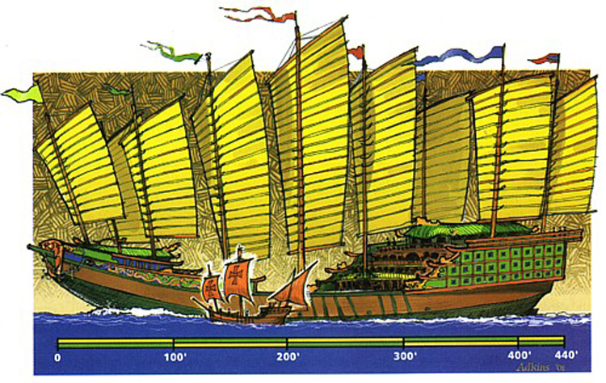

Slide 5
Chinese Reconnaissance
End of the voyages, 1433
Confucian ministers mistrusted foreign alliances
Resources redirected to agriculture and defense of northern borders
Technology of building large ships was forgotten, nautical charts destroyed

Slide 6
MOTIVES FOR EXPLORATION
Portugal searched for fresh resources
Resource poor country block from expanding on land
13th to 15th century they ventured out onto Atlantic
Established sugar plantations in Azores, Madiera
Direct trade without Muslim intermediaries
Bypass Italian trade monopolies with Ottomans
Asian spice trade
African gold, ivory, and slaves
Missionary efforts of European Christians
Christians urged to spread the faith throughout the world
Crusades and holy wars against Muslims in early centuries
Reconquista of Spain inspired Iberian crusaders
Motives
Gold, glory, God
Combined and reinforced each other

Slide 7
European Exploration- Portugal
European exploration in the Atlantic and Indian Oceans
Portuguese exploration
European goals: to expand Christianity and commercial opportunities
Portuguese mariners emerged as the early leaders
Prince Henry of Portugal determined to increase Portuguese influence
Seized Moroccan city of Ceuta in 1415
Colonization of the Atlantic Islands
Portuguese ventured into the Atlantic, colonized Madeiras, Azores, other islands
Italian investors, Portuguese landowners cultivated sugarcane on the islands
Slave trade expanded fifteenth century
Portuguese traders ventured down west coast of Africa
Traded guns, textiles for gold and slaves
Thousands of slaves delivered to Atlantic island plantations
Indian Ocean trade
Portuguese searched for sea route to Asian markets without Muslim intermediaries
Portuguese mariners dominated trade between Europe and Asia, sixteenth century
Portuguese ships with cannons launched European imperialism in Asia

Slide 8
European – African Relationship
Europeans and Africans had been familiar with one another for thousands of years.
No history of racial bigotry – Several Roman Emperors were black Africans.
Europe lacked any large deposits of gold and had to trade for it.
Europe traded iron and other goods for African gold (from the Gold Coast)

Slide 9
Reconquesta
A series of wars fought over 700 years.
Fighting was between Christian princes in Europe and Muslims on the Iberian Peninsula.
Spain is slowly developed as a kingdom during the period.
1492 – The Battle of Grenada – Spanish win.

Slide 10
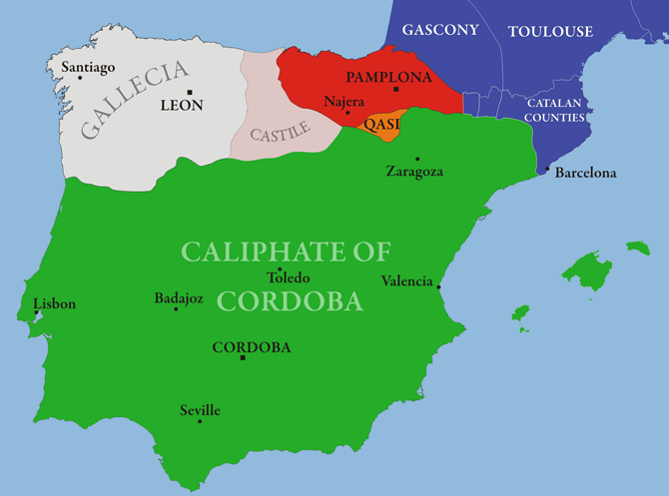

Slide 11
Columbus and Contact
Ferdinand and Isabella acquire a vast sum of Muslim gold during their conquest.
Christopher Columbus was searching for funding for his expeditions.
Believed the Earth was smaller than it was understood to be and thought he could sail to Asia.
Runs into the Caribbean: Seems to believe he is near Japan.

Slide 12
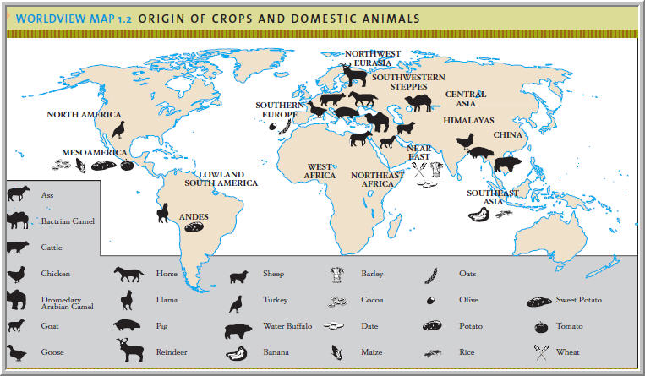
Why do Europeans dominate the Indigenous Americans?

Slide 13
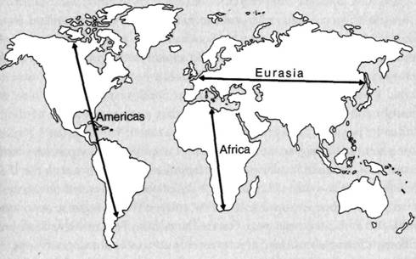
Transmission
Crop/livestock transmission is easier in the Eastern Hemisphere.

Slide 14
Guns, Germs, and Steel
Eurasian-African technology is more sophisticated than the Indigenous peoples of the Americas possess.
Germ resistance is much more developed in Eurasian-Africans than Indigenous Americans.
Geographically determined!

Slide 15
European Domination in Africa
Mass die-off of American Indians.
Hordes of easily accessible American gold flow into European coffers.
Africans are undercut in the gold trade
Must find another product to trade for European goods- labor!
Europeans need labor in the Americas
Indians cannot be easily enslaved – flee or die from Eurasian diseases.
Africans are already resistant to Eurasian diseases!

Slide 16
Europe Overshadows the Middle East and East Asia
Europe, rich from American plunder, undergoes a huge economic and technological expansion.
400% global inflation rate.
Muslim and East Asian Empires are not defeated, but simply left behind.

Slide 17
GLOBAL EXCHANGES
Biological exchanges between Old and New Worlds
Columbian Exchange
Global diffusion of plants, food crops, animals, human populations, diseases
Columbus's voyages began and explorations furthered exchange
All continents effected
Permanently altered the earth's environment
Epidemic diseases
Smallpox, measles, diphtheria, whooping cough, and influenza
Led to staggering population losses
Smallpox reduced Aztec population by 95 percent in one century
Contagious diseases had same horrifying effects in the Pacific islands
Between 1500/1800, 100 million people died of imported diseases
New foods and domestic animals
Wheat, horses, cattle, sheep, goats, and chickens went to Americas
American crops included maize, potatoes, beans, tomatoes, peppers, peanuts
Growth of world population: from 425 million in 1500 to 900 million in 1800
Migration of human populations
Enslaved Africans were largest group of migrants from 1500 to 1800
Sizable migration from Europe to the Americas

