Slide 1
Why Europe?
Global Economy and the Rise of European Dominance

Slide 2
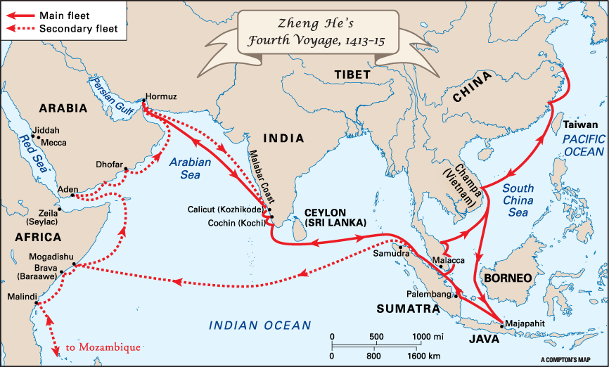
China, Zheng He, and What Might Have Been
In the 1400s, China undertook a program of exploration naval empire building.
A vast fleet of trading and warships was assembled and launched to explore the Indian Ocean under Admiral Zheng He.

Slide 3
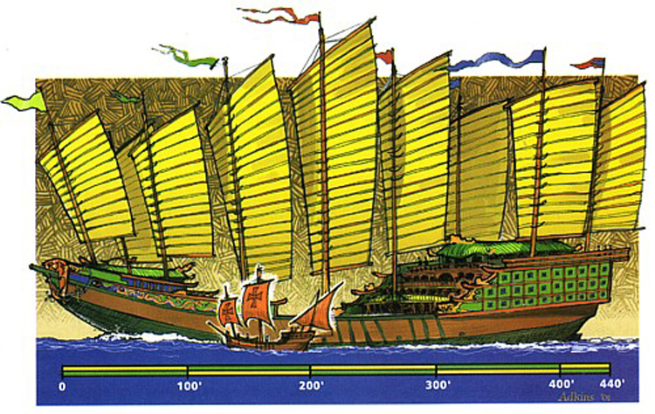

Slide 4
Chinese Reconnaissance
Voyages end in 1433
Renewed wars with barbarians.
Resources shifted to improving agriculture.
General Chinese mistrust of “adventurism.”

Slide 5
European – African Relationship
Europeans and Africans had been familiar with one another for thousands of years.
No history of racial bigotry – Several Roman Emperors were black Africans.
Europe lacked any large deposits of gold and had to trade for it.
Europe traded iron and other goods for African gold (from the Gold Coast)

Slide 6
Reconquista
A series of wars fought over 700 years.
Fighting was between Christian princes in Europe and Muslims on the Iberian Peninsula.
Spain is slowly developed as a kingdom during the period.
1492 – The Battle of Grenada – Spanish win.

Slide 7
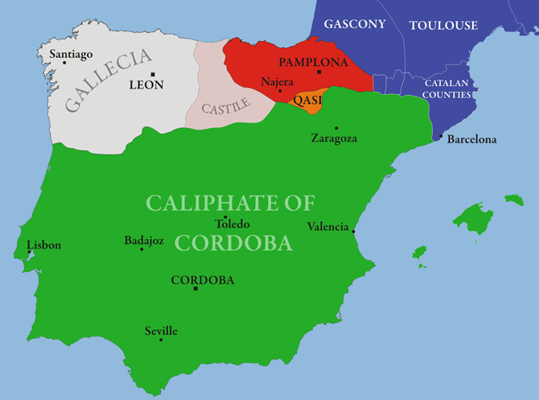

Slide 8
Columbus and Contact
King Ferdinand and Queen Isabella acquire a vast sum of Muslim gold at the Battle of Grenada.
Christopher Columbus was searching for funding for his expeditions- Spanish monarchs are flush with cash!
Believed the Earth was smaller than it was understood to be and thought he could sail to Asia.
Runs into the Caribbean: Seems to believe he is near Japan.

