Slide 1
Why Europe?, Part II
Global Economy and the Rise of European Dominance

Slide 2
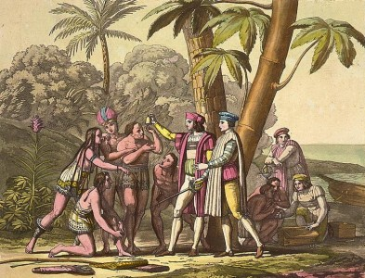
Contact
Columbus arrives in the Americas and makes contact with the Arawaks.
Technologically primitive, but Columbus is impressed with their good health and generosity.
Begins to enslave them.

Slide 3
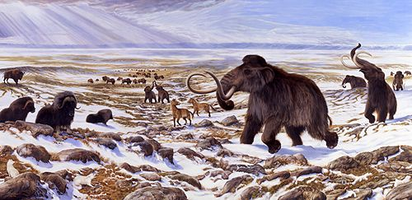
Who are the American Indians?
17,000 years ago, hunter-gatherers crossed the Beringia Land Bridge from Asia to the Americas.
11,000 years ago, rising sea levels “sank” the Beringia Land Bridge.
American Indian cultures had been “cut-off” from the rest of humanity for over 10,000 years.

Slide 4
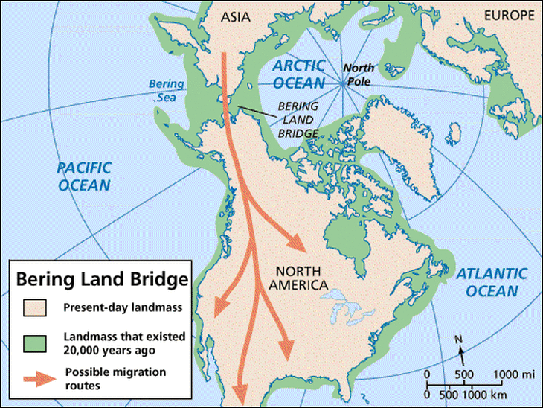

Slide 5
Geographic Differences
The Americas
1 large domesticated mammal
Major grain crops yielded less calories and took more effort to grow.
Were unable to use animal power to farm.
Eurasia/Africa
13 large domesticated mammals
Major grain crops were calorie-rich and simple to grow.
Used animal power to farm.

Slide 6
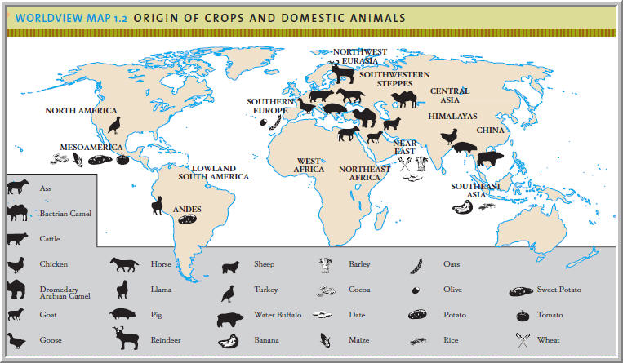
Why do Europeans dominate the Indigenous Americans?

Slide 7
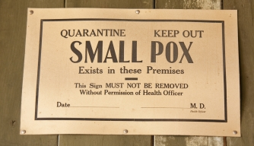
Diseases
Europeans carry diseases to which the American Indians have no experience.
95% of the American Indian population dies off, mostly from smallpox.
Germ resistance is much more developed in Eurasian-Africans than Indigenous Americans.

Slide 8
Europeans vs American Indians
Eurasian-African technology is more sophisticated than the Indigenous peoples of the Americas possess: cultural contact!
Eurasians/Africans have regular contact with one another and exchange information: American Indians do not.

Slide 9
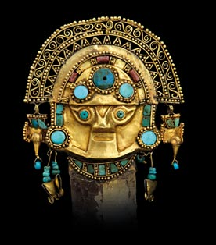
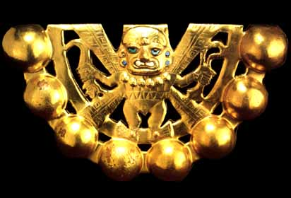
American Gold!
Central/South America have large deposits of gold and silver.
Indians are unable to fight back against the Europeans, who simply pillage their gold.

Slide 10
European Domination in Africa
Mass die-off of American Indians.
Hordes of easily accessible American gold flow into European coffers.
Africans are undercut in the gold trade
Must find another product to trade for European goods- labor!
Europeans need labor in the Americas
Indians cannot be easily enslaved – flee or die from Eurasian diseases.
Africans are already resistant to Eurasian diseases!

Slide 11
Europe Overshadows the Middle East and East Asia
Europe, rich from American plunder, undergoes a huge economic and technological expansion.
400% global inflation rate.
Muslim and East Asian Empires are not defeated, but simply left behind.

